Slide 1

KNOWLEGDE REPRESENTATION
AI-2002

Slide 2
Objective
Knowledge Representation
Propositional Logic
Predicate Logic

Slide 3
Knowledge Representation
It is responsible for representing information about the real world so that a computer can understand and can utilize this knowledge to solve the complex real world problems such as diagnosis a medical condition or communicating with humans in natural language.
It is also a way which describes how we can represent knowledge in artificial intelligence. Knowledge representation is not just storing data into some database, but it also enables an intelligent machine to learn from that knowledge and experiences so that it can behave intelligently like a human.

Slide 4
Propositional Logic
Proposition means sentences. Propositional logic applies the Boolean logic to convert our real-world data into a format that is readable to the computer. For instance, if we say ‘It is hot and humid today’, the machine won’t understand. But if we can create propositional logic for this sentence, then, we can make the machine-read, and interpret our message.
Derived from Boolean logic, the heart of propositional logic is the idea that the final output (meaning) of all propositions are either true or false. It can’t be both.
For example, ‘Earth is round’, the output for this proposition is TRUE. If we say, ‘Earth is square’, then the output is FALSE.
Propositional logic applies to those sentences where the output can only be either TRUE or FALSE.

Slide 5
Propositional Logic
But if we refer to the sentence like ‘Some children are lazy’ then here we have two possible outputs. This preposition is TRUE for those children who are lazy, but it is FALSE for those children who are not lazy. So, for such sentences/propositions where two or more outputs are possible, propositional logic doesn’t apply.

Slide 6
Types of prepositions
There are two types of prepositions, atomic and complex, that can be represented through propositional logic. Atomic means a single preposition like ‘the sky is blue’, ‘hot days are humid’, water is liquid, etc.
Complex prepositions are those, which have been formed by connecting one, two, or more sentences.

Slide 7
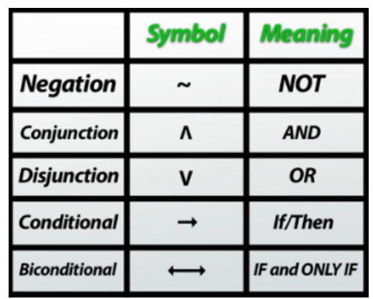
Symbols
In propositional logic, there are five symbols to create the syntax to represent the connection of two or more sentences. Syntax means a proper structure to represent information.

Slide 8
Example
Ram can play tennis (let’s take it as variable X)
Ram cannot play tennis – There is a negation in the sentence, so symbolic representation will be ˜ X
Ram can play tennis and badminton – Note, there is a new addition ‘Badminton’, let’s take it as variable Y. Now, this sentence has a Conjunction, so symbolic representation will be X ˄ Y
Ram can play tennis or badminton – Here is a Disjunction, so symbolic representation will be X ˅ Y
If Ram can play tennis then he can play badminton – There is a condition, so symbolic representation will be X → Y
Ram can play tennis if and only if he can play badminton – It is a biconditional sentence, so symbolic representation will be X ↔ Y

Slide 9
Disadvantages of PL
If you want to represent complicated sentences or natural language statements, PL is not sufficient.
There is very limited expressive power in PL, so we use FOL instead.
The sentence shown below cannot be represented we cannot using PL logic.
Examples
I love mankind. It’s the people I can’t stand!
Joe Root likes football.
I like to eat mangos.
PL is not enough to represent the sentences above, so we require powerful logic (such as FOL).

Slide 10
Predicate Logic or first-order logic (FOL)
FOL is also called predicate logic. It is a powerful language used to develop information about an object and express the relationship between objects.
FOL not only assumes that does the world contains facts (like PL does), but it also assumes the following:
Objects: A, B, people, numbers, colors, wars, theories, squares, pit, etc.
Relations: It is unary relation such as red, round, sister of, brother of, etc.
Function: father of, best friend, third inning of, end of, etc.

Slide 11
Parts of first-order logic
FOL also has two parts:
Syntax
Semantics
Syntax
The syntax of FOL decides which collection of symbols is a logical expression.
The basic syntactic elements of FOL are symbols. We use symbols to write statements in shorthand notation.

Slide 12
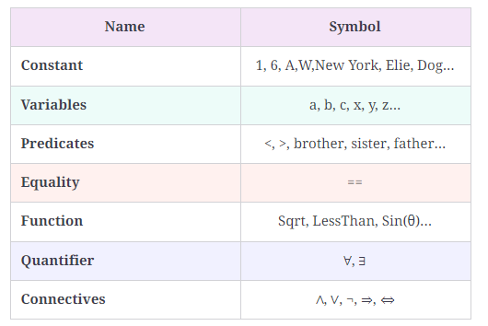
Basic elements of FOL

Slide 13

Atomic and complex sentences in FOL
1. Atomic Sentence
This is a basic sentence of FOL formed from a predicate symbol followed by a parenthesis with a sequence of terms.
We can represent atomic sentences as a predicate (value1, value2…., value n).
Example
John and Michael are colleagues → Colleagues (John, Michael)
German Shepherd is a dog → Dog (German Shepherd)
2. Complex sentence
Complex sentences are made by combining atomic sentences using connectives.
FOL is further divided into two parts:
Subject: the main part of the statement.
Predicate: defined as a relation that binds two atoms together.
Example
Colleague (Oliver, Benjamin) ∧ Colleague (Benjamin, Oliver)
“x is an integer”
It has two parts;
first, x is the subject.
second, “is an integer” is called a predicate.

Slide 14
Quantifiers and their use in FOL
Quantifiers allow us to determine or identify the range and scope of the variable in a logical expression.
There are two types of quantifiers:
Universal quantifier: for all, everyone, everything.
Existential quantifier: for some, at least one.

Slide 15
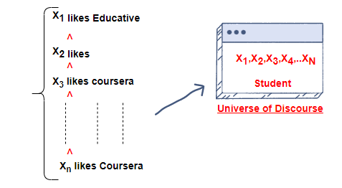
Universal quantifiers
Universal quantifiers specify that the statement within the range is true for everything or every instance of a particular thing.
Universal quantifiers are denoted by a symbol (∀) that looks like an inverted A. In a universal quantifier, we use →.
If x is a variable, then ∀x can read as:
For all x
For every x
For each x
Example
Every Student Likes Educative.
Explanation
So, in logical notation, it can be written as:
∀x student(x) → likes(x, Educative)
This can be interpreted as: There is every x where x is a student who likes Educative.

Slide 16
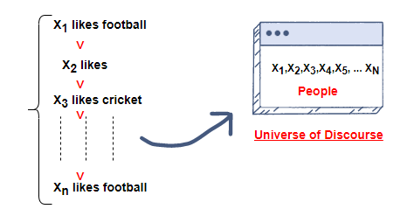
Existential quantifiers
Existential quantifiers are used to express that the statement within their scope is true for at least one instance of something.
∃, which looks like an inverted E, is used to represent them. We always use AND or conjunction symbols.
If x is a variable, the existential quantifier will be ∃x:
For some x
There exists an x
For at least one x
Example
Some people like Football.
Explanation
So, in logical notation, it can be written as:
∃x: people(x) ∧ likes Football(x)
It can be interpreted as: There are some x where x is people who like football.

Slide 17
Nested quantifiers & their uses
We can use both quantifiers together, but it’s not a type of quantifier; rather, it’s an outlier category.
Nested quantifier refers to when one quantifier is within the scope of another quantifier.
These quantifiers can be represented using the ∃x∀x signs.
Here are some examples to understand this type of quantifier.
∃xy ∀x ∀y((x< 0) ∧ (y< 0) → (xy = 8))
This can be interpreted as: For every real number x and y ∈ ℝ, if x is negative and y is also negative, implies for some values of xy must be equal to 8.

Slide 18
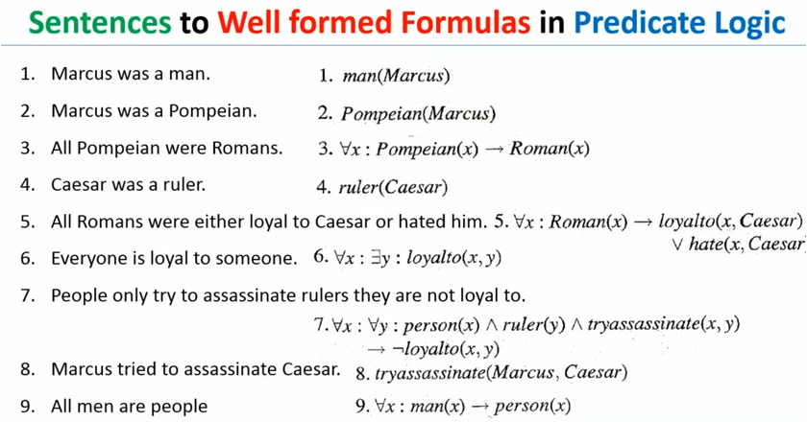

Slide 19
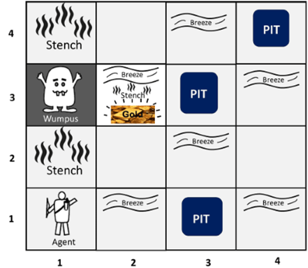
Wumpus World(Propositional logic example)
There are also some components which can help the agent to navigate the cave.
The rooms adjacent to the Wumpus room are smelly, so that it would have some stench.
The room adjacent to PITs has a breeze, so if the agent reaches near to PIT, then he will perceive the breeze.
There will be glitter in the room if and only if the room has gold.
The Wumpus can be killed by the agent if the agent is facing to it, and Wumpus will emit a horrible scream which can be heard anywhere in the cave.
Left turn,
Right turn
Move forward, backward
Grab

Slide 20
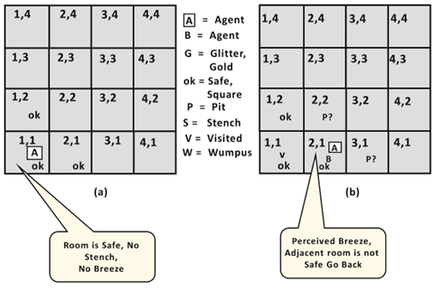
Agent's First & Second step:
Initially, the agent is in the first room or on the square [1,1], and we already know that this room is safe for the agent, so to represent on the below diagram (a) that room is safe we will add symbol OK. Symbol A is used to represent agent, symbol B for the breeze, G for Glitter or gold, V for the visited room, P for pits, W for Wumpus.
At Room [1,1] agent does not feel any breeze or any Stench which means the adjacent squares are also OK.
Now agent will stop and think and will not make any harmful move. The agent will go back to the [1, 1] room. The room [1,1], and [2,1] are visited by the agent, so we will use symbol V to represent the visited squares.

Slide 21
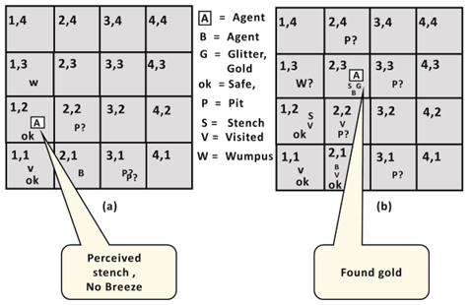
Agent's 3 &4 Step:
But Wumpus cannot be in the room [1,1] as by rules of the game, and also not in [2,2] (Agent had not detected any stench when he was at [2,1]). Therefore agent infers that Wumpus is in the room [1,3], and in current state, there is no breeze which means in [2,2] there is no Pit and no Wumpus. So it is safe, and we will mark it OK, and the agent moves further in [2,2].
At room [2,2], here no stench and no breezes present so let's suppose agent decides to move to [2,3]. At room [2,3] agent perceives glitter, so it should grab the gold and climb out of the cave.

Slide 22
Atomic proposition variable for Wumpus world:
Let P_{i,j} be true if there is a Pit in the room [i, j].
Let B_{i,j} be true if agent perceives breeze in [i, j], (dead or alive).
Let W_{i,j} be true if there is wumpus in the square[i, j].
Let S_{i,j} be true if agent perceives stench in the square [i, j].
Let V_{i,j} be true if that square[i, j] is visited.
Let G_{i,j} be true if there is gold (and glitter) in the square [i, j].
Let OK_{i,j} be true if the room is safe.

Slide 23
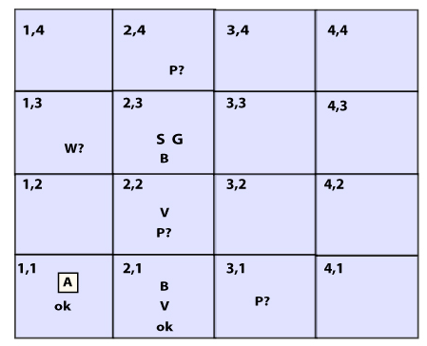
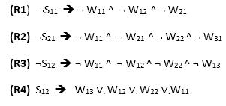
Atomic proposition variable for Wumpus world
Some Propositional Rules for the wumpus world:

Slide 24
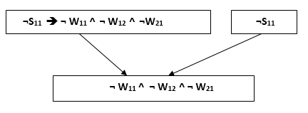
Prove that Wumpus is in the room (1, 3)
We will firstly apply MP rule with R1 which is ¬S₁₁ → ¬ W₁₁ ^ ¬ W₁₂ ^ ¬ W₂₁, and ¬S₁₁ which will give the output ¬ W₁₁ ^ W₁₂ ^ W₁₂.
Apply And-Elimination Rule:
After applying And-elimination rule to ¬ W₁₁ ∧ ¬ W₁₂ ∧ ¬ W₂₁, we will get three statements: ¬ W₁₁, ¬ W₁₂, and ¬W₂₁.
Modus Ponens will be applied on other states and the unit Resolution to reach goal

